Slide 1



PLEDGE TO PROGRESS
Sustainability Hackathon
Sponsored By
Your Team Name : Mother_Nature_Earth
Your team bio :
Rakhee Vyas, IT professional,
Rishika Agrawal, BTECH IT student
Vishwaraj Khanderao, IT professional
Date :30/04/2023
// ‹#›
//01

Slide 2
Problem Statement?
When I was a teen the weather was complete different, the climatic conditions have had been changing a lot since then had a zeal to do something for nature i had submitted a global warming project in my college days. To protect the mother nature earth is collective responsibility.we see a lot of destructive impacts of this global warming and nature changes lots of species are on the verge of extinction. All around the world there are so many natural disasters occuring. Every year Amazon forest catches fire due to the heat produced by the environmental changes. Lots of living creatures are getting impacted due to this, it's not only the air pollution but all other forms of pollution causing this as of now to start with air pollution since this will have drastic change in global warming process if we achieve to control it. All of this is due to the change in environment.
// ‹#›
//01

Slide 3
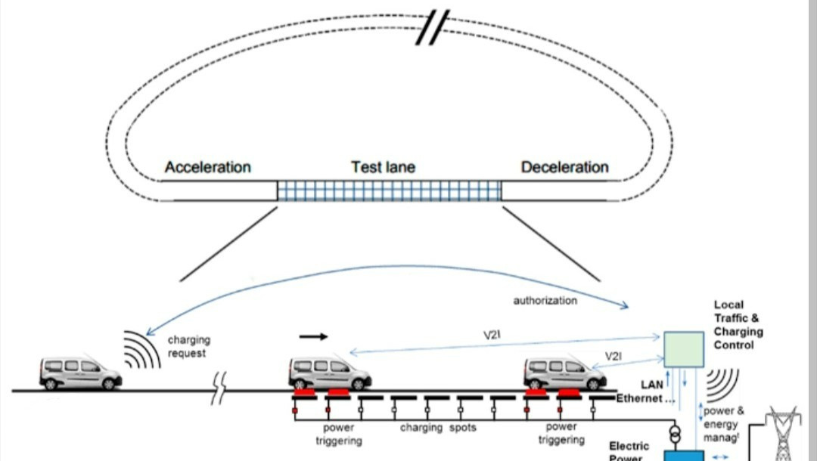
Architecture Diagram
// ‹#›
//01

Slide 4
Project Overview Part - 1
To have smart energy management for electric roads using solar energy to charge vehicles, while incorporating Azure and MSM (Microsoft Smart Energy Management), we follow these steps for our project:
1. Solar Energy Generation: Install solar panels along the electric roads to generate renewable energy. Ensure the panels are positioned optimally for maximum sunlight exposure.
2. Energy Storage: Set up energy storage systems, such as batteries, to store excess energy generated during the day. This stored energy can be used during low solar generation periods or during high demand.
3. Smart Metering: Implement smart metering infrastructure to monitor energy consumption and generation in real-time. Smart meters can provide data on individual vehicle charging, road energy usage, and overall energy flows.
4. Data Collection and Analysis: Connect the smart metering infrastructure to Azure IoT (Internet of Things) Hub. This allows for the collection and analysis of energy data from various sources, including solar generation, battery storage, and vehicle charging.
5. Azure IoT Suite: Utilize Azure IoT Suite, which offers a range of services for building and managing IoT applications. Leverage Azure IoT Hub, Azure Stream Analytics, and Azure Machine Learning to process and analyze the collected energy data.
// ‹#›
//01

Slide 5
Project Overview Part-2
6. Energy Demand Prediction: Used historical and real-time data to develop predictive models like LSTM, Linear regression and light GBM model that forecast energy demand for vehicle charging. Azure Machine Learning helped create accurate demand prediction models based on factors like traffic patterns, weather conditions, and historical usage.
7. Energy Management Algorithms: Develop energy management algorithms that optimize the energy distribution and charging schedules based on demand predictions and available solar energy. These algorithms can determine the most efficient use of stored energy and prioritize charging for vehicles with immediate needs. Used function app for this from Azure and set energy consumption as a threshold. Also used gradio library for web deployment.
8. Vehicle-to-Grid Integration: Implement Vehicle-to-Grid (V2G) technology, which allows electric vehicles to discharge excess energy back into the grid when not in use. This feature helps stabilize the grid and provide additional power during peak demand periods.
9. Integration with Microsoft Smart Energy Management: Utilize Microsoft Smart Energy Management (MSM) solutions to integrate with the energy management system. MSM offers additional features like for calculating cost of energy consumed, real-time monitoring, and energy optimization algorithms and reduction/sustainability goals.
// ‹#›
//01

Slide 6
Project Overview Part-3
10. Feedback and Iteration: Continuously monitor the system's performance and gather feedback to refine the algorithms and improve energy management efficiency. Use the insights gained from data analysis to optimize charging schedules, maximize solar energy utilization, and enhance overall energy management.
By implementing these steps, we created a smart energy management system for electric roads that efficiently utilizes solar energy, incorporates Azure's powerful data analysis capabilities, and integrates with Microsoft Smart Energy Management for enhanced features and optimization.
// ‹#›
//01

Slide 7
User Segment & Pain Points
Government sector or private big brands can start it on a small scale as a prototype, every year government build roads by investing in it this solution would result in reducing the financial cost and also during the cement roads being build upon there is a lot of traffic congestion, am a IT professional and see this as part of daily life. Lots of species which we used to see during teenage don't exist now squirrels, birds, we are cutting down the trees and these species don't have shelters and many more such examples like water species due to water pollution and other animals including humans are all impacted due to this .natural disasters causing so much of damage every year even roads are damaged during natural disasters.
// ‹#›
//01

Slide 8
Pre-Requisite
Alternatives is solar vehicles which consume natural renewable resources instead of petrol, diesel, gases or even electricity because that as well generates while using water but that even would need tar/cement roads so we still will be investing in building roads every year. and competitors could be the vehicle manufacturing industries. I completely understand it would impact the industries and the people who are working in these industries and related jobs but then we need to have other job opportunities and the future is technology and most importantly we need to save our mother nature earth. If we save our nature we can live else living creatures including humans will be on the verge of extinction slowly.
// ‹#›
//01

Slide 9
Tools or resources
Metal escalators can be used to build these roads and these roads can be operated using technology where we have the age of identifying the natural disasters before they occur using data science and machine learning so in such cases these roads can be hidden just like when a ship goes below the bridge and bridge is opened the similar way these roads can be opened and closed to avoid the roads getting impacted and many accidents will not occur since the disasters would be known well in advance, it could start with a small prototype.
// ‹#›
//01

Slide 10
Any Supporting Functional Documents
https://m.engineeringnews.co.za/article/dutch-solar-road-proves-successful-moves-on-to-heavy-traffic-road-trial-2018-10-19/rep_id:4433
there has already been an example or solar roads in Dutch which is successful i had this idea since my college days.
// ‹#›
//01

Slide 11
Implementation requirements
a large-scale implementation of an electric road system can be done by identifying:
(i) which roads;
(ii) how much of the road network; and
(iii) which vehicle types are beneficial to electrify based on an analysis of current road traffic volumes, CO2 emissions mitigation potential, and infrastructure investment costs, prioritizing roads with high-traffic loads, how much solar energy can be accumulated and other parameters if any.
// ‹#›
//01

Slide 12
Challenge/Opportunity/Use Cases
Challenges:
1. Interoperability which means that an electric road system would have to be able to provide power to any kind of vehicle. Today no standards and system architecture exists for the transfer of power from the grid to the ERS to multiple vehicles.
2. Improvements in the range of electric truck batteries which could quickly make ERS charging redundant
3. Implementing it on a large scale without planning
4. Analysis of number of vehicles and traffic congestion and other implementation parameters.
5. Usage and adoption, technical education and awareness
6. solar/electric energy charging
7. since this idea also supports vehicles just kept on the escalators and the escalators moves to the destination point it can be tried on a small scale if this happens but then it would be a big impact on the vehicle manufacturing industries and drivers loosing jobs, nevertheless it could be tried on a small scae lanes or where people can move without vehicles like a short distance roads.
8. Static or plug-in charging systems which is the only system with established global standards and proven technology. Plug-in charging stations are quickly growing in numbers
// ‹#›
//01

Slide 13
Challenge/Opportunity/Use Cases
Opportunities:
There could be plenty of job opportunities in the technical sector with this implementation.
opportunities in the IT sector will also increase with this.
with this implementation health opportunities will improve a lot since the pollution of one kind goes down other respective parameters and other types of pollution control would fall in place automatically.
It's a complete future technology opportunity for roads systems with the increasing use of fuel and vehicles where we dont have parking slots in some countries and fuel is also also the verge of extinction renewable sources of energy can play a very vital role to save the planet earth while saving all the living creatures.
// ‹#›
//01

Slide 14
Challenge/Opportunity/Use Cases
Use Case 1:
An Israeli firm called ElectRoad recently announced that it has been testing a similar system on an 80-foot test track. As Scientific American recently reported, it now plans to build out a system along a section of bus route in Tel Aviv, with the longer-term vision of installing a system on the entire 11-mile shuttle link between the city of Eilat and Ramon International Airport.
The benefits are fairly clear. If a vehicle can be charged as it goes, it doesn’t need to pull up at the side of the road be plugged into an electrical supply; it can, in theory, run indefinitely. It also means that vehicles can make do with far smaller batteries (they still need them for acceleration), saving a lot of weight and expense. And placing inductive charging hardware on the road is safer, prettier, and more versatile than using live overhead lines to power electric vehicles.
There are disadvantages. First, it requires tearing up sections of road to lay, which is disruptive and expensive. Second, the systems themselves aren’t exactly cheap, requiring a continuous line of electromagnets for the length of the road. As result, the infrastructure would be unlikely to extend beyond a few high-traffic routes through a city.
But it may still work for the kinds of bus routes that ElectRoad envisions, where less weight means more efficiency and routes are standardized. And it may even make sense for the robotic taxi fleets that we keep hearing about, if they broadly stick to well-defined routes and only deviate from charging strips for a mile or two at a time.
https://www.google.com/amp/s/www.technologyreview.com/2017/05/18/151622/the-case-for-building-roads-that-can-charge-electric-cars-on-the-go/amp/
// ‹#›
//01

Slide 15
Challenge/Opportunity/Use Cases
Use Case 2:
A solar roadway in Peachtree Corners, Georgia is apparently the only one currently operational in the U.S. It was installed in late 2020 using WattWay road panels. However, the project is very limited in scope and occupies a narrow strip within an autonomous vehicle test lane
https://www.greencarreports.com/news/1130542_georgia-gets-first-solar-roadway-in-the-us
Microsoft Cloud Technologies which can be used:
Microsoft Azure for data science and machine learning would be best suitable to be used since these technologies will help in predicting the natural disasters if any so that we can take precautionary actions to avoid and unforseen accidents or calamities.
// ‹#›
//01

Slide 16
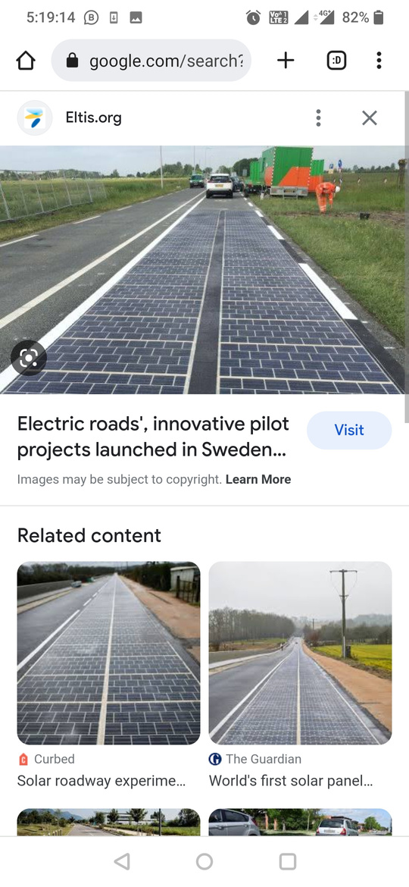
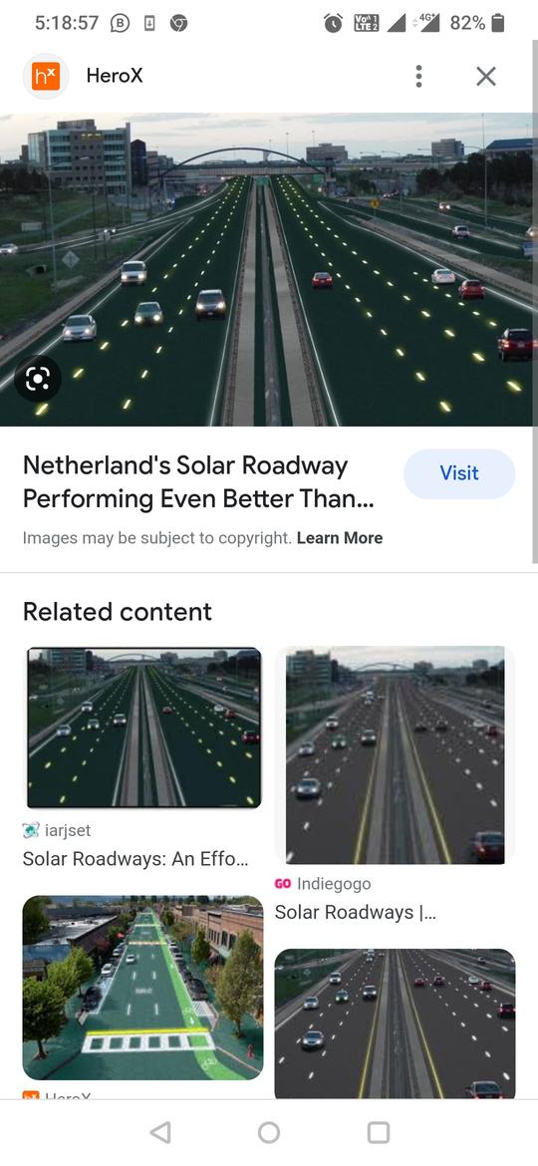
GitHub Repository Link & supporting diagrams, screenshots, if any
https://github.com/rakheeindia09/sustainability-hack/tree/main/idea
// ‹#›
//01

Slide 17


Thank You
Rakhee Vyas, Rishika Agrawal, Vishwaraj Khanderao

